Slide 1

BOPRC R Lesson #1: Fundamentals of R
May 13, 2025

Slide 2
Topics
Why R?
Basics for using R
Using Projects in R
Real code examples
Install some packages
Create new objects in R
Read in data from a .csv and a .xls file
Use base R functions
Access help documentation for functions

Slide 3
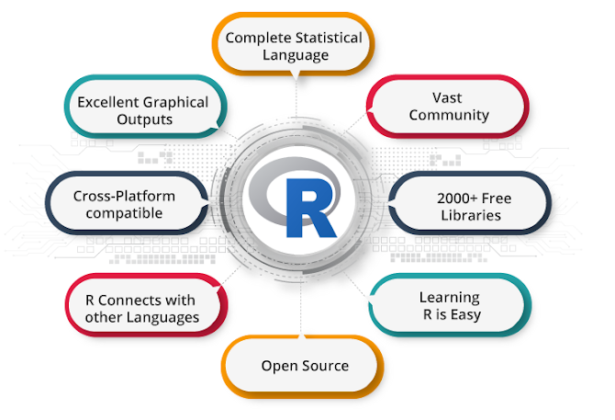
Why use R??
R is a free, platform-independent software environment
Software of choice for academic, governmental, and private industries
Numerous user-created packages
Worldwide support network
Requires you to think more deeply about research questions, data, and analyses
Reproducibility
Image: DevTechnosys

Slide 4

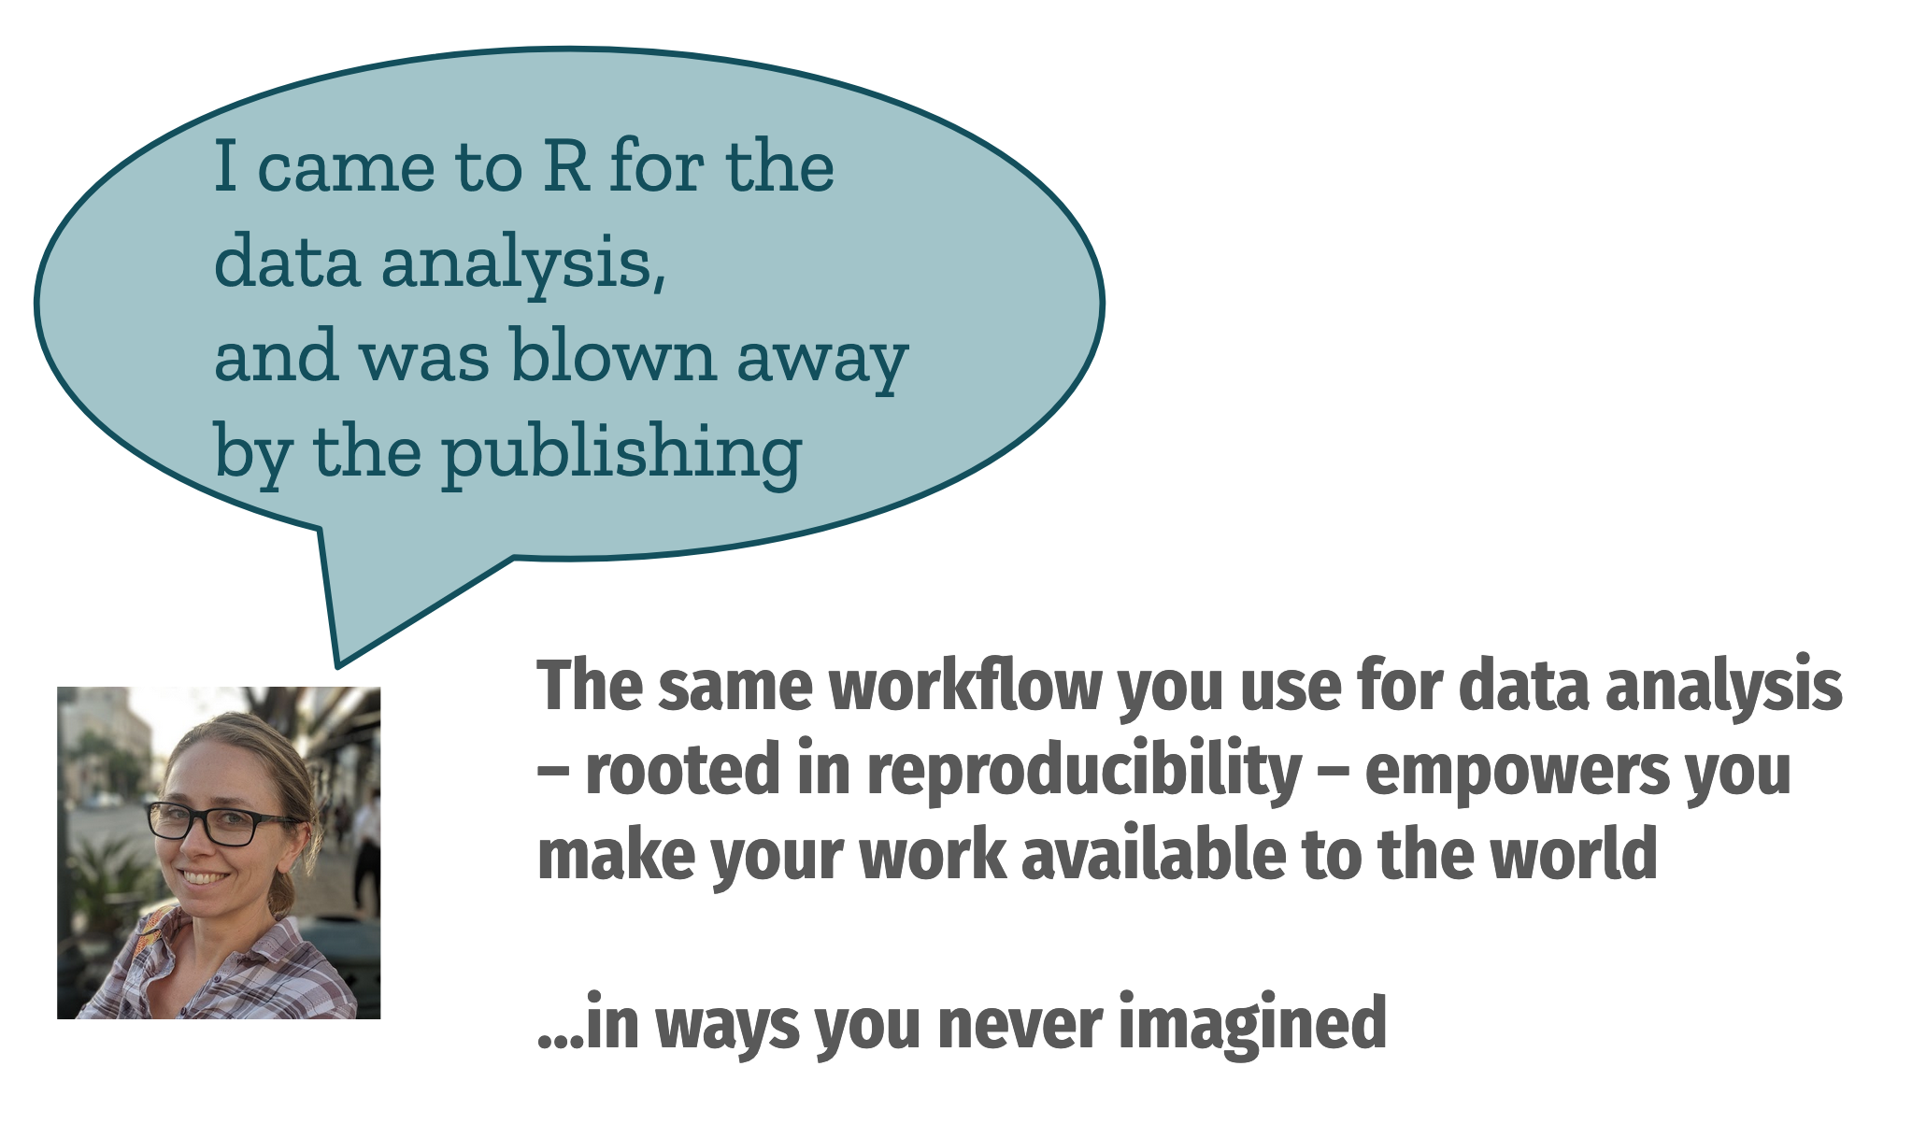
Why use R??
Reproducible and repeatable
For scientific publishing
For other scientists
For future you
Transparent
Shareable (GitHub)
Promotes open science
Image: Technology Networks Informatics
Image: Openscapes

Slide 5


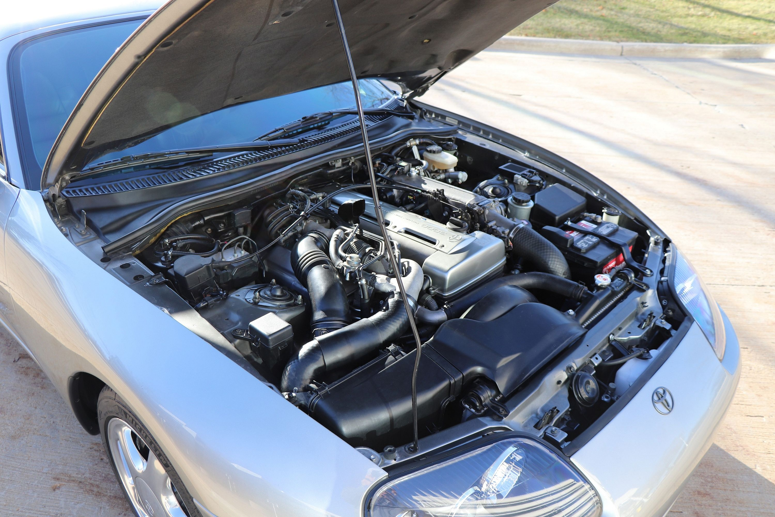
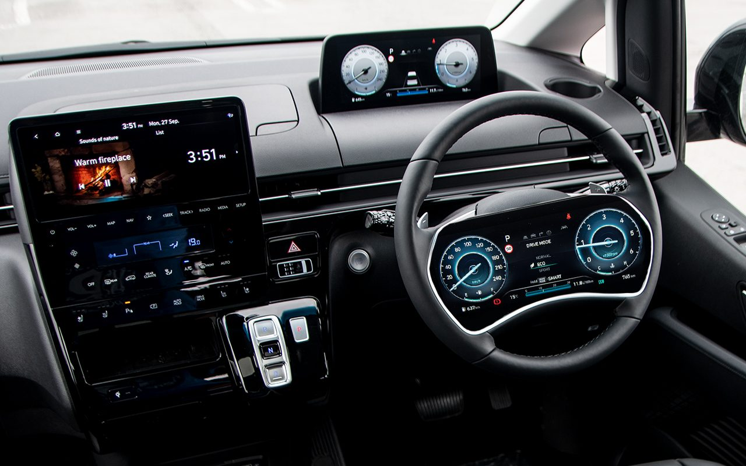
Image: CarBuzz
Image: NZ Autocar Magazine

Slide 6
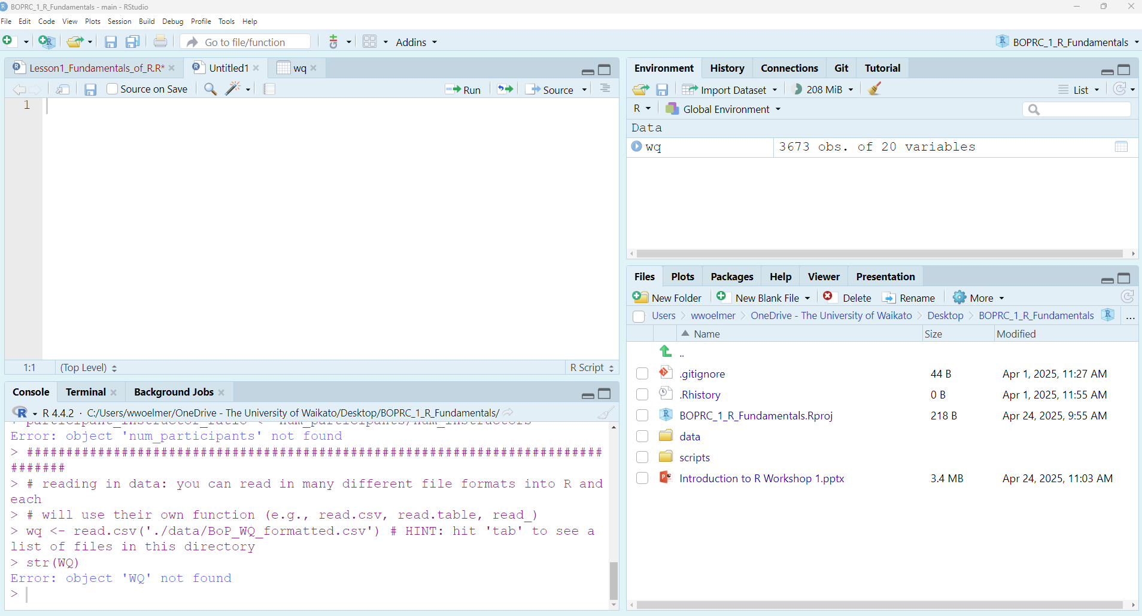
2. ENVIRONMENT
1. SOURCE
Click “Run” or hit CTRL + ENTER to send code to console
This is where you write your code!
Your code will not be evaluated until you “Run” to the console
Here you can see what objects are in your workspace
4. FILES/PLOTS/PACKAGES/HELP
3. CONSOLE
Here you can see file directories, view plots, browse packages, and access R Help
This is where your code from the Source is run by R.
You can also use the console to perform actions you don’t need to save

Slide 7
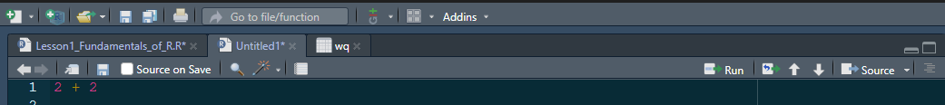
Creating objects in R
You can type code in the editor or the console. Run code from the editor to source into the console (hit ‘Run’ or CTRL + ENTER with your cursor anywhere in the line of code)
SOURCE
CONSOLE

Slide 8
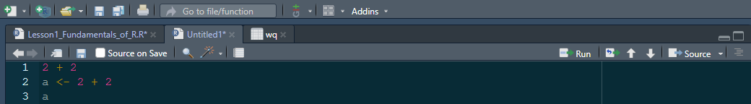
Creating objects in R
R is object-oriented. You can create and modify objects in R sequentially
SOURCE
CONSOLE

Slide 9
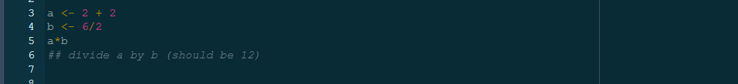
Creating objects in R
Once you create objects, you can manipulate them. This is the power of R!
Anything with ## is a ‘comment’ and is ignored by R

Slide 10
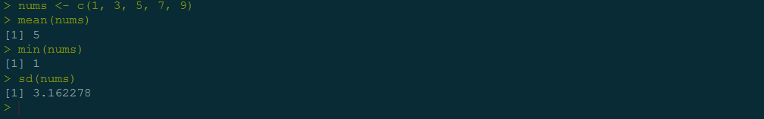
Using functions in R
Functions act as an algorithm to perform a specific task
They require specific inputs, which you can see using ?help documentation
Many functions are built into R

Slide 11
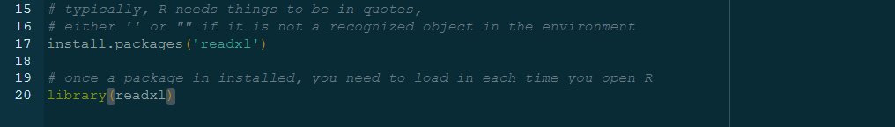
Using functions in R
You can also install packages in R created by others that perform specific actions
NOTE: change CRAN mirror to U of Auckland
Once a package is installed on your computer, you only need to load the library next time you open Rstudio
You can also create custom functions (more on that if there is interest!)

Slide 12
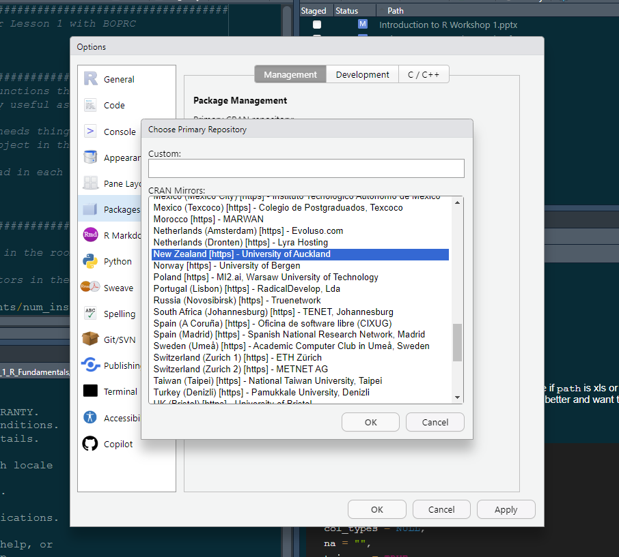
Under global options -> Packages

Slide 13
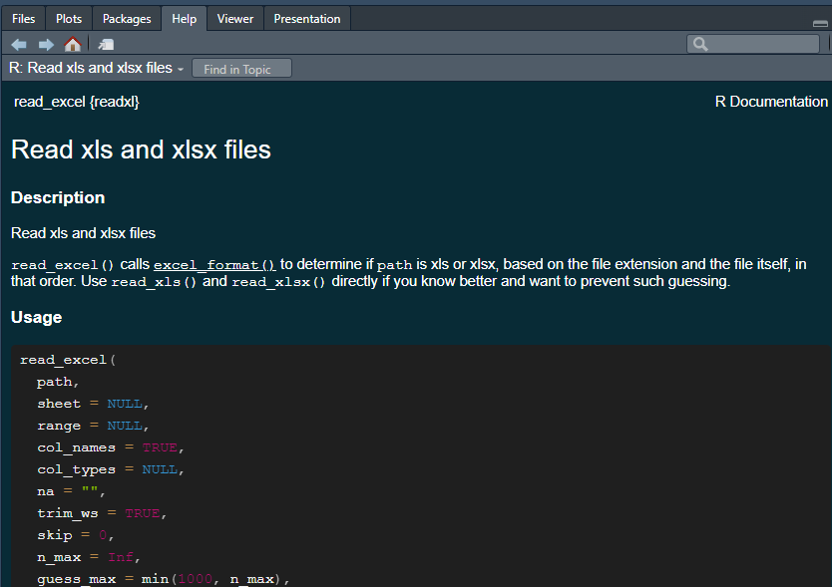
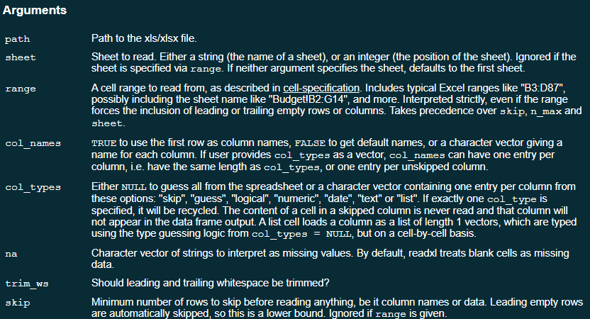
Using functions in R
Functions often have default settings, which can be changed, and require certain inputs

Slide 14

Using a function to create an object
Let’s say we have an excel file we want to read into R
We’ve named the dataframe ‘buoy’ which will show as an object in the environment

Slide 15
Using a function to create an object
Let’s say we have an excel file we want to read into R
The name of the function to read in the excel file. Run ?read_excel for help documentation

Slide 16
Using a function to create an object
Let’s say we have an excel file we want to read into R
Most of the arguments have defaults, except for path, which is the location of the data. This must be provided in ‘’ or “”

Slide 17
Using a function to create an object
Let’s say we have an excel file we want to read into R
The default is ‘skip = 0’ but our file has 3 rows at the top of the file that are just header information which we want to skip

Slide 18
Using a function to create an object
Let’s say we have an excel file we want to read into R
Note that each argument is separated by a comma
You don’t need to specify ‘path’ but it can help with organizing

Slide 19
Naming things in R
 | GOOD | BAD (less good…)
Use intuitive, descriptive names | buoy <- read.csv(‘./data/buoy_data.csv’) ctd <- read.csv(‘./data/ctd_data.csv’) | df <- read.csv(‘./data/buoy_data.csv’) df2 <- read.csv(‘./data/ctd_data.csv’)
R is case sensitive, be consistent with capitalization | buoy_rotoehu <- read.csv(‘./data/buoy_data.csv’) ctd_rotoehu <- read.csv(‘./data/ctd_data.csv’) | buOy_Rotoehu <- read.csv(‘./data/buoy_data.csv’) ctd_rotoehu <- read.csv(‘./data/ctd_data.csv’)
Don’t use spaces or special characters | ctd_data <- read.csv(‘./data/ctd_data.csv’) | ctd data <- read.csv(‘./data/ctd_data.csv’)
Keep it simple | ctd <- read.csv(‘./data/ctd_data.csv’) | ctd_2019_Rotoehu_bop_temp_do_chl_all_depths_df2 <- read.csv(‘./data/ctd_data.csv’)
Don’t name something the same as a function | thermo_depth <- thermo.depth(data$temp, data$depth) | thermo.depth <- thermo.depth(data$temp, data$depth)

Slide 20

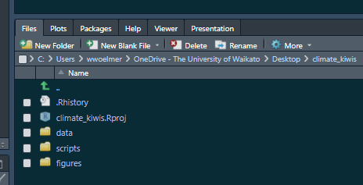



Project-oriented Workflows
Enables repeatability (for yourself)
Enables reproducibility (for someone else)

Slide 21
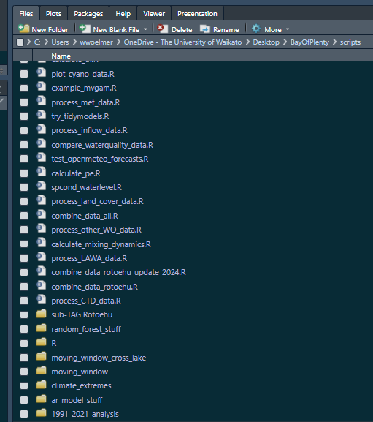
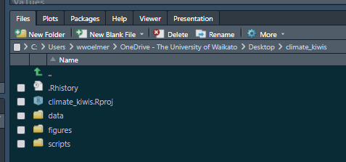
How to use projects
Ideally, these are truly “project”-specific
A set of analyses towards a common goal, typically a manuscript

Slide 22
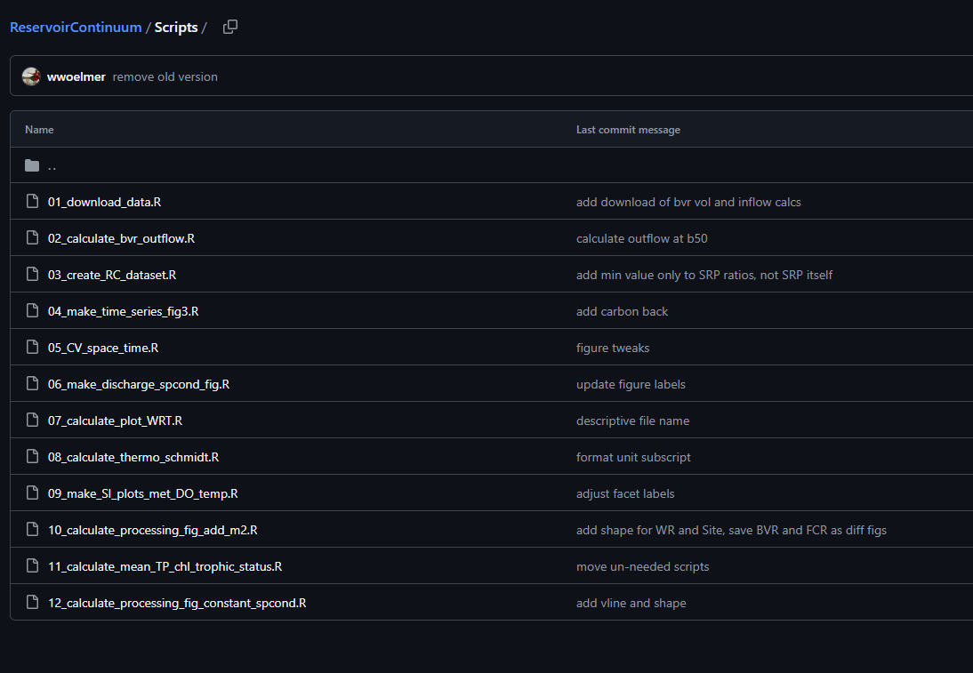
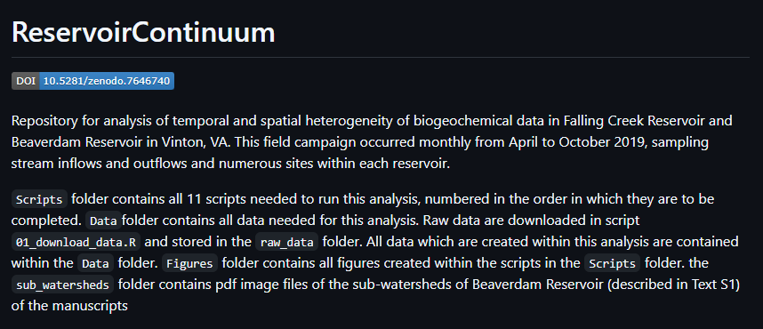
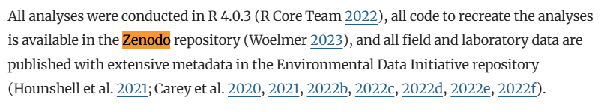
Manuscript within a project
https://github.com/wwoelmer/ReservoirContinuum

Slide 23
Let’s go to a working example
Link here to a Github repository: https://github.com/wwoelmer/BOPRC_1_R_Fundamentals
Objectives of Lesson 1: R Fundamentals
Install and use packages
Create new objects in R
Read in data from a .csv and a .xls file
Understand data classes
Use base R functions to subset and calculate summary statistics
Plot data using ggplot

Slide 24
Let’s go to a working example
Link here to a Github repository: https://github.com/wwoelmer/BOPRC_1_R_Fundamentals
Download a zipped folder from the link above
Unzip the folder on your computer (Desktop is a good go-to)
Create a project in RStudio using an existing directory (where you unzipped the folder)
Open the script “Lesson1_Fundamentals_of_R.R” in RStudio

Slide 25
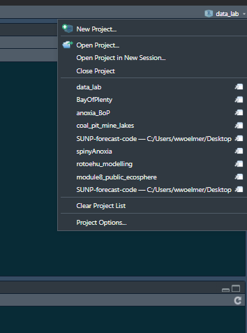
Setting up a “Project” in R
Step 1: Open RStudio
Step 2: Select “New Project” in upper right in Rstudio

Slide 26
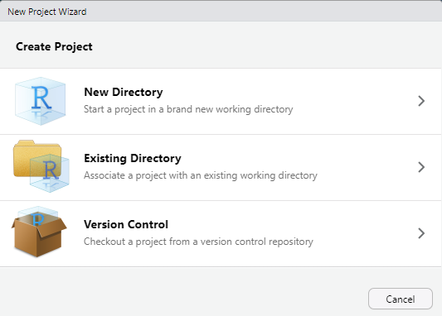
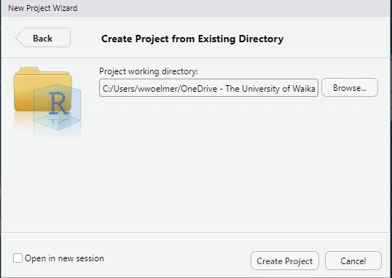
Setting up a “Project” in R
Step 1: Open RStudio
Step 2: Select “New Project” in upper right in Rstudio
Step 3: Select “Existing Directory” -> Navigate to where you unzipped the folder on your PC

Slide 27
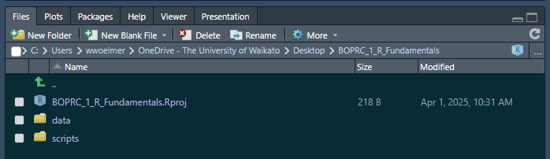
File structure in R should look like this (but on your computer)

Slide 28
Some “homework”…
Download Lesson 2 (LINK) and create a project in R
Run through Data Carpentries, Data analysis and visualization in R for Ecologists: https://datacarpentry.org/R-ecology-lesson/index.html

Slide 29
Extra files for different lessons if needed

Slide 30
Best practices in R
Use projects
Use relative directories
Organize your files
Start with an empty environment, don’t save your workspace
Re-run/test your code every time you open R
You should be able to close R, re-open R, and get back to where you were before
Double-check your output—R will usually give you something (exactly what you asked for), but did you tell it the right thing?
Use ChatGPT, but take it with a grain of salt…

Slide 31
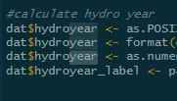
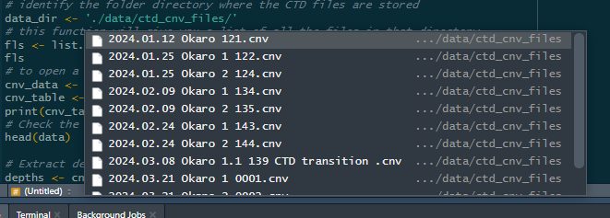
Tips and tricks…
Symbol | Shortcut | Description
%>% | Ctrl + Shift + M | “pipe” operator, reads: whereby
<- | Ctrl + - | Assigning operator
 | Ctrl + Shift + F | Search through all your scripts
 | Alt + Shit + select | Select multiple lines of code
 | Hit “tab” when typing a directory ‘./data/’ + Tab | Will show you a list of items in the directory to choose from

Slide 32
When to put (or keep) things in your script vs in the console
Script = things you want to rerun next time you open Rstudio
Console = things you just need to check for now and don’t need to reproduce later

Slide 33
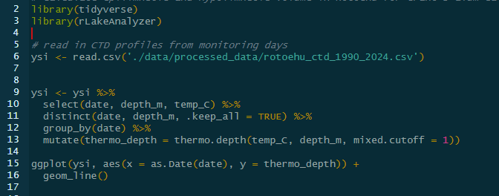
When to put (or keep) things in your script vs in the console
Script = things you want to rerun next time you open Rstudio

Slide 34
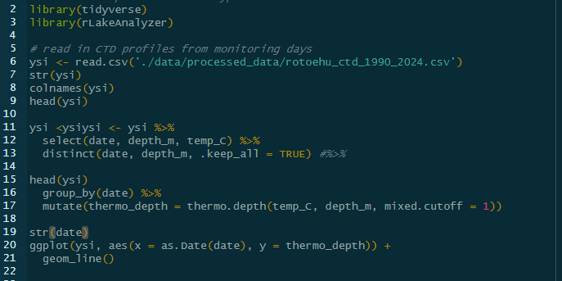
When to put (or keep) things in your script vs in the console
Script = things you want to rerun next time you open Rstudio
But coding is an iterative process, so when you’re coding it might look more like this

Slide 35
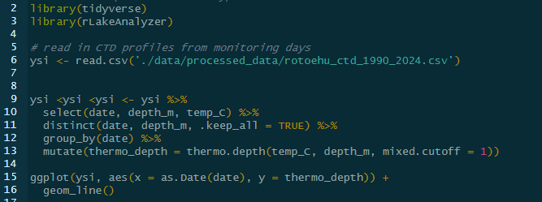
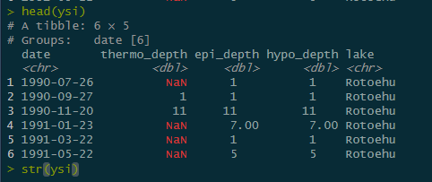
When to put (or keep) things in your script vs in the console
Script = things you want to rerun next time you open Rstudio
Console = things you just need to check for now and don’t need to reproduce later
Script
Console

Slide 36
Useful resources
Numerous “How-to” videos, lectures, and exercises for getting started in R
Style guidelines in R
Blog on project-oriented workflows
ChatGPT and Google
Article on suggestions for how to best utilize ChatGPT
When first starting out, if you wouldn’t be able to explain what the code is doing, try not to use it—or ask someone to help you understand
ChatGPT will give you functions, for loops, etc. These are more advanced techniques that you will need to write yourself some day
Each other!

Slide 37
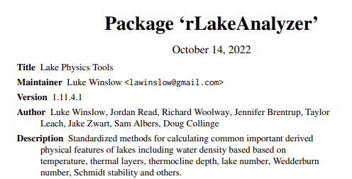

What is RLakeAnalyzer?
A set of tools for calculating common physical lake metrics in R (e.g., heatmaps, thermocline depth, Schmidt stability)
Part of GLEON (Global Lake Ecological Observatory Network) project that was led primarily by PhD students originally in 2011 and has been continuously updated
The code underlying the package and a couple examples can be found here: https://github.com/GLEON/rLakeAnalyzer
A description of functions here: https://cran.r-project.org/web/packages/rLakeAnalyzer/rLakeAnalyzer.pdf

Slide 38
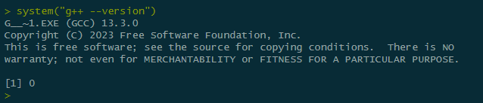
Installing Rtools
Rtools is needed for downloading packages which need compilationg (i.e., those that are not on CRAN, custom packages which someone has built)
Download Rtools from here: https://cran.r-project.org/bin/windows/Rtools/rtools44/rtools.html
Then run
system("g++ --version")
In rstudio. If you get a single number (127) that means Rtools is not properly installed. If you get an output like that below, it worked!

